Slide 1

Administrative Management System
Cabuntas, John Neover
Cudanes, Eriel Clifford
Bolivar, Sebastian
Olanda, Kent Russel
Dalanan, Chriselda
Notes:
Line spacing + Page numbers

Slide 2
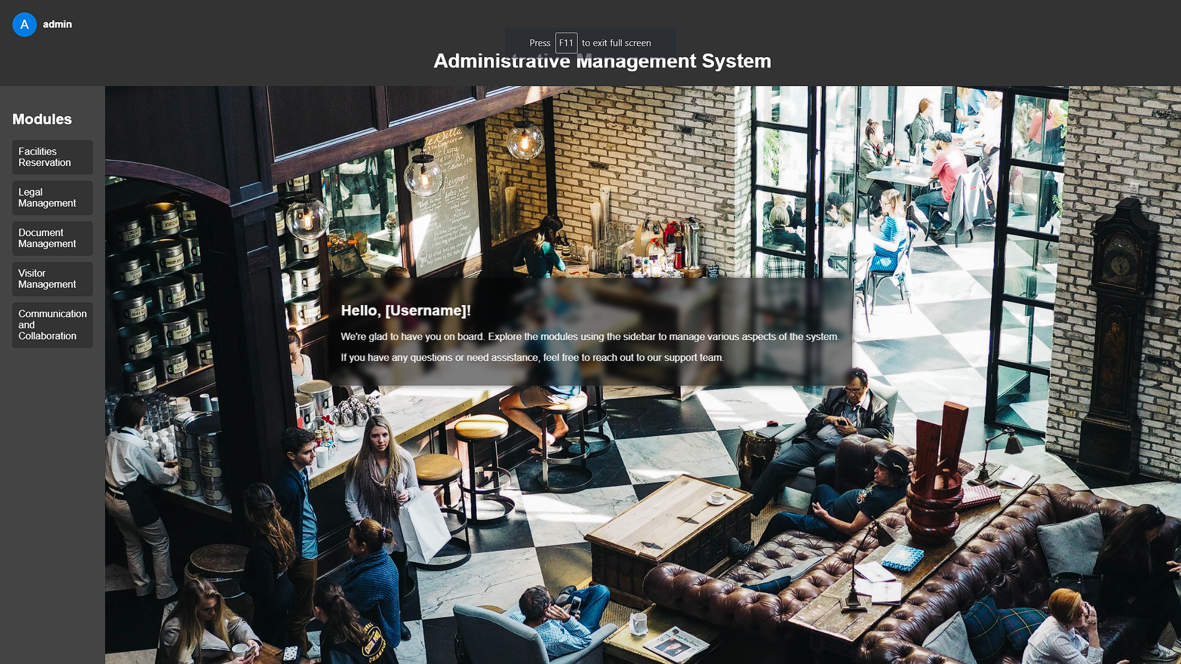
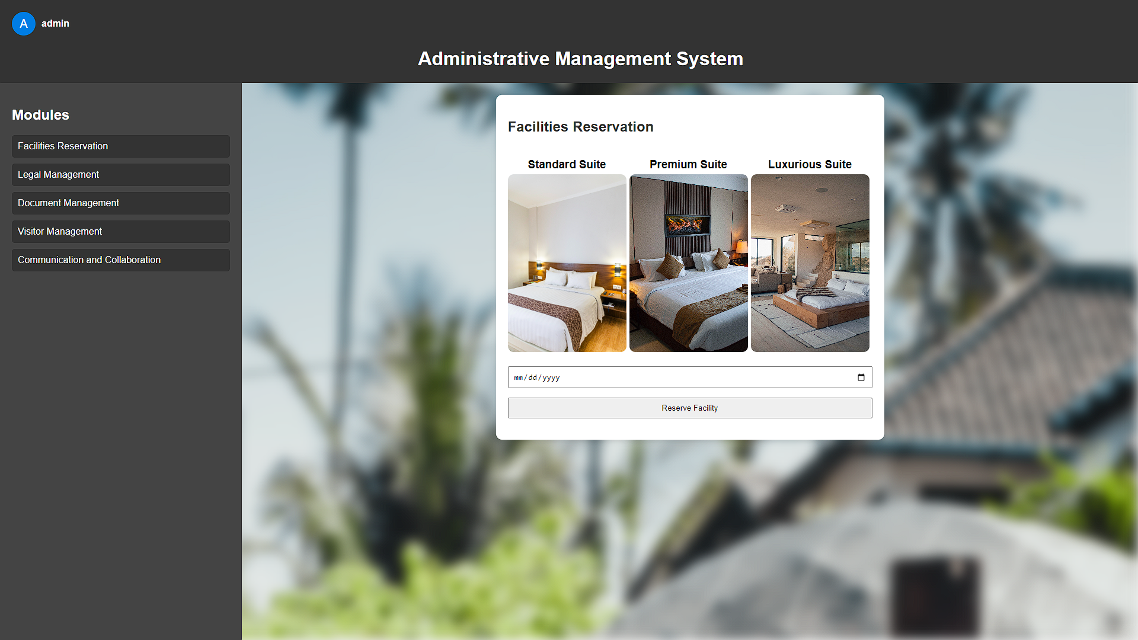
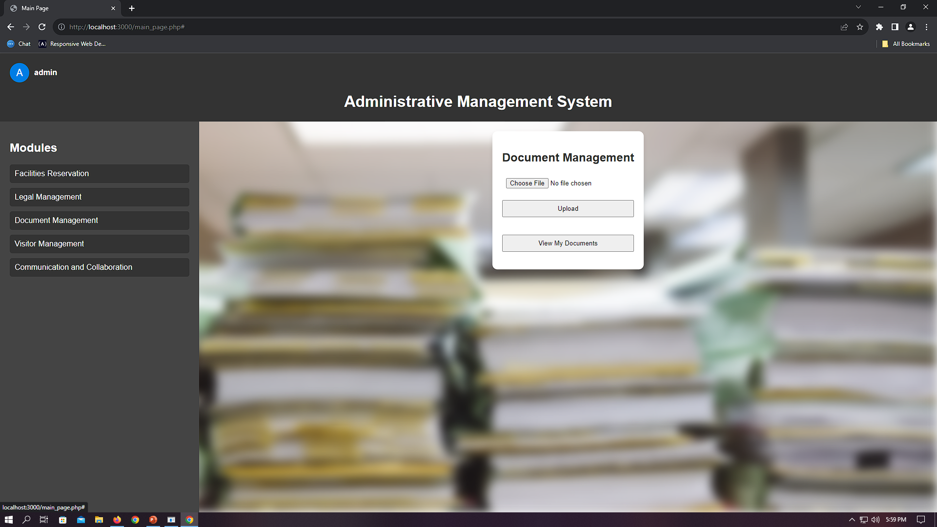
iNTRODUCTION
The development of a Administrative System Management. The project aims to create an administrative system with components for facilities reservation, legal management, document management, visitor management, and communication and collaboration.

Slide 3
Project Scope
LOGIN
MODULES (e.g Facilities Reservation)
DATABASE
END
Scope:
Developing an Administrative Management System with user registration, login, and several modules (facilities reservation, legal management, document management, visitor management, and communication collaboration.) The system aims to improve overall efficiency in managing various administrative functions.

Slide 4
Deliverables / Objectives
Fully functional Administrative Management System.
User registration module
Login module
Facilities reservation module
Legal management module
Document management module
Visitor management module
Communication collaboration modul
Completed system documentation.
Automate key administrative tasks.
Reduce operational errors and delays.

Slide 5
Issue
Inefficient Task Management
Description: businesses often face challenges in coordinating tasks effectively. Traditional methods, such as manual management, lead to delays and errors. This inefficiency can impact overall productivity.

Slide 6
Feasibility Study
Technical Feasibility:
System Requirements: The project aligns with the existing technical infrastructure. Compatibility checks indicate smooth integration.
Technology Stack: The chosen technologies demonstrate stability and scalability, ensuring long-term support.
Economic Feasibility:
Cost-Benefit Analysis: Initial investment in software and training is offset by anticipated efficiency gains. The project is economically viable.
ROI Projections: The Return on Investment (ROI) is projected to exceed expectations within the first year.
The feasibility study indicates that Administrative Management System is not only technically, economically, but also aligns with legal and regulatory standards. The resource allocation further support the project's feasibility, providing a foundation for successful implementation.

Slide 7
Project Phases
Initiation: Project idea, identification of stakeholders, and preliminary planning.
Planning: Detailed project planning, including scope, schedule, budget, and risk management.
Execution: System development and implementation.
Monitoring and Controlling: Regular tracking of project activities and making necessary adjustments.
Closing: Project completion and handover.

Slide 8
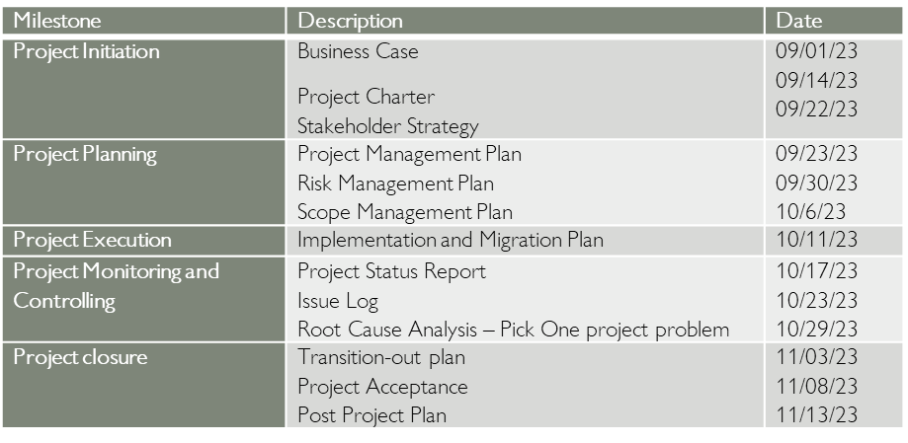
Milestone

Slide 9
Time Management
Task | Duration (Weeks) | Start Date | End Date
Project Initiation | 1 | 09/01/2023 | 09/07/2023
Requirements Gathering | 1 | 09/08/2023 | 09/14/2023
System Design | 2 | 09/15/2023 | 09/28/2023
Database Setup | 1 | 09/29/2023 | 09/05/2023
UI/UX Development | 3 | 09/06/2023 | 09/26/2023
Backend Development | 4 | 09/27/2023 | 10/25/2023
System Deployment | 1 | 10/26/2023 | 11/01/2023
Documentation | 1 | 11/02/2023 | 11/08/2023
Project Review and Closure | 1 | 11/09/2023 | 11/14/2023

Slide 10
Top 3 Risk
During Creation
Risk | Risk Level
1. Scope Creep | High
2. Budget Overrun | Low
3. System Bugs | Med
During Live
Risk | Risk Level
1. Data Security Breach | High
2. User Adoption | Med
3. Integration Issues | Low

Slide 11
Contingency Plan
Risk: Scope Creep
Description: Changes in project scope not adequately documented or managed.
Mitigation Strategy: Clear project scope definition and regular communication with stakeholders.
Contingency Action: Establish a change control board to evaluate and approve any scope changes. Assess the impact on timeline and resources before implementation.
Risk: Data Security Breach
Description: Unauthorized access to sensitive project data.
Mitigation Strategy: Implementation of robust security measures and regular security audits.
Contingency Action: Immediate response plan in case of a security breach, involving IT security experts to assess, contain, and resolve the issue.

Slide 12
Issues
Project: Administrative Management System
Issue | Description | Priority (H, M, L) | Category | Reported By | Assigned To | Status | Date Resolved | Resolution/ Comments
001 | Error in Facilities Reservation module. | H | Bug | D. Ocao | 0. Kent Russel | Closed | Oct 8, 2023 | Fixed the code logic.
002 | Unable to generate legal reports. | M | Functionality | H. Darryl | C. Clifford | Closed | Oct 18, 2023 | Fixed the code logic.
003 | Document upload issue. | L | User Interface | H. Ardabe | B. Sebastian | Closed | Oct 28, 2023 | Implemented UI fix.

Slide 13
Roles and Responsibilities
Role | Responsibilities | Name/Title
Facilities reservation | Efficiently manage and schedule physical spaces. | Kent Russel Olanda
Legal management | Oversee legal documents and ensure compliance. | Eriel Clifford Cudanes
Document management | Organize and secure digital and physical documents. | Sebastian Heart Bolivar
Visitor management | Register and monitor visitors for security. | John Neover Cabuntas
Communication and collaboration. | Enhance communication and teamwork. | Chriselda Dalanan
Project Manager | Manages the project team | Jay Cullo

Slide 14
Communication Management
Types | User Stories | Responsible | Method | Date
Daily Stand-up Meetings | As a team member, I want a daily stand-up meeting to discuss tasks, challenges, and achievements. | IT Developers | Daily stand-up meetings via Messenger / Discord | Every weekday at 9:30 PM

Slide 15
Stakeholders
Key | Organization | Power (1-5) | Interest (1-5)
A | End Users | 1 | 3
B | Owner | 5 | 5
C | IT Dev | 3 | 3
D | Manager | 4 | 4
Interest
Power

Slide 16
Work Breakdown Structure
ADMINISTRATIVE MANAGEMENT SYSTEM
Requirements Gathering
Facilities Reservation
Legal Management
Document Management
Visitor Management
Communication and Collaboration
Design
User Interface Design
Database Design
Testing and Monitorings
System Testing
Performance Testing
Ongoing System Monitoring
Deployment
Deployment Planning
User Training
Transition to Live Operations

Slide 17
Work Breakdown Structure
Level | WBS Code | Element Name | Description of Work
1 | 1 | Administrative Management System
2 | 1.1 | Requirements Gathering
3 | 1.1.1 | Facilities Reservation | Gather and document requirements for the facilities reservation module.
 | 1.1.2 | Legal Management | Define and document requirements for the legal management module.
 | 1.1.3 | Document Management | Document requirements for the document management module.
 | 1.1.4 | Visitor Management | Gather requirements for the visitor management module.
 | 1.1.5 | Communication and Collaboration | Define requirements for the communication and collaboration module.
2 | 1.2 | Design
3 | 1.2.2 | User Interface Design | Create the user interface design.
 | 1.2.3 | Database Design | Design the database structure.
2 | 1.3 | Testing and Monitoring
3 | 1.3.1 | System Testing | Conduct system testing.
 | 1.3.2 | Performance Testing | Test system performance under various conditions.
 | 1.3.3 | Ongoing System Monitoring | Establish a system monitoring process.
2 | 1.4 | Deployment
3 | 1.4.1 | Deployment Planning | Develop a deployment plan.
 | 1.4.2 | User Training | Provide user training.
 | 1.4.3 | Transition to Live Operations | Plan and execute the transition to live use.

Slide 18
Cost, Benefit, Budget
Action | Action Type | Description | First year costs (- indicates anticipated savings)
Investment in Project | Cost | Initial investment required for project development. | ₱ 200,000.00
Cost Reduction | Benefit | Reduction in operational costs due to the efficient function of the administrative management system. Facility Reservation Manager Document Management Manager Visitor Management Manager Legal Management Manager Communication And Collaboration Manager | Facility Reservation Manager ₱ -23,000.00 Document Management Manager ₱-46,000.00 Visitor Management Manager ₱-28,000.00 Legal Management Manager ₱-52,000.00 Communication And Collaboration Manager ₱-33,000.00
Net First Year Savings |  |  | ₱-18,000.00

Slide 19
Project Status
The Scope remains on track, meeting defined requirements and objectives. In terms of Schedule, a yellow cautionary signal indicates a minor deviation, attributed to unforeseen technical challenges in the development phase. Mitigation plans are underway to address these challenges promptly.
Regarding Cost, the project is within the acceptable range, with no significant deviations identified. Risks are flagged as red due to unexpected technical challenges, prompting the execution of contingency plans.
For Quality, ongoing testing and validation efforts are in place to ensure adherence to established standards. In summary, while facing challenges, the project is actively managing and mitigating issues to maintain overall progress and deliver on time.

Slide 20
Software Development
In our Agile ecosystem, we operate on two-week sprints, fostering regular communication through daily stand-up meetings.
Our coding standards dictate uniform naming conventions, consistent code formatting.
In our project, rather than traditional version control, we've adopted a collaborative module development approach. Each team member is assigned specific modules, fostering a focused and efficient development process.

Slide 21
Project Conclusion & Recommendation
The completion of Administrative Management System has been a pivotal milestone in our academic journey. It provided hands-on experience in system development, fostering collaboration, problem-solving, and effective communication within the team. Overcoming challenges underscored the importance of flexibility and adaptability, reinforcing our commitment to project timelines.
Based on our experience, we recommend allocating ample time for project planning during the initiation phase. Regular team communication and status updates are crucial for maintaining transparency. We suggest incorporating continuous learning through workshops and team-building activities for skill enhancement and stronger interpersonal relationships. Emphasizing project planning and regular reviews will contribute to successful project management.

